Slide 1

Welcome to East Park Primary School
Early Years - FS2

Slide 2
Whole School Values & Behaviour
Our school values are: Respect Grow Believe Achieve Together
We approach behaviour using the 3 P’s – Polite, Prepared & Proud.
We celebrate ‘Good to be Green’ & ‘Great to be Gold’ behaviour.
We establish clear routines and have high expectations for all learners – every classroom uses a visual timetable.
We teach a carefully planned curriculum - Knowledge & Skills
We support emotional intelligence through PSHE (Jigsaw), Unique Umbrella and ELSA interventions for pupil’s needing additional emotional support .

Slide 3
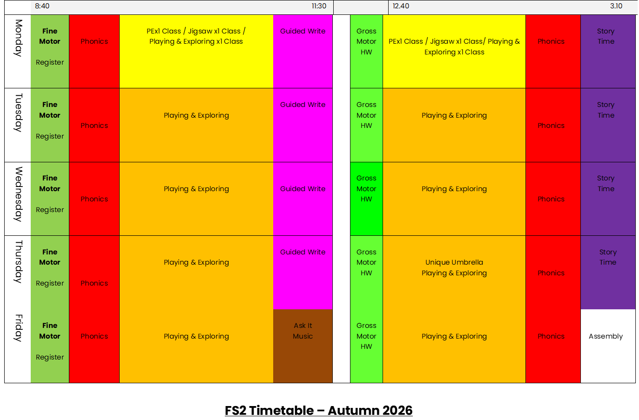
A Typical Day in FS2

Slide 4
Oracy, Communication
& Language in FS2
Oracy means learning to speak and listen well - sharing thoughts, explaining ideas, asking questions and listening to others.
Communication and language develop through everyday interactions, play and conversation - not just formal activities.
Talking, listening and sharing ideas help children develop confidence, build friendships and get ready to learn.

Slide 5
Wellcomm
This year, we will be using Wellcomm to help us understand your child’s communication and language development.
It helps us identify what your child can already do and where we can provide additional support.
It helps us plan appropriate activities to support every child’s development.
It is not about passing or failing - it helps us make sure children get the right support at the right time.

Slide 6
How can you Support your
Child at Home?
You are your child’s most important communication partner, and the everyday conversations you share at home make a real difference!
Talk, talk, talk! Chat about your day, ask open-ended questions and give your child time to respond. Encourage your child to speak in sentences.
Talk during everyday activities. Cooking, shopping, getting dressed and walking to school are great opportunities to learn new words.
Play, imagine and take turns. Pretend play, games and conversations help children practise listening, explaining and expressing their ideas.
Listen and encourage. Get down to your child’s level, show interest, allow thinking time and model new words naturally.

Slide 7
Further Support at Home
Model rather than correct. If your child says “Him goed home,” you could reply, “Yes, he went home,” naturally modelling the correct language.
Build on what your child says. If they say “big dog,” you could respond, “Yes, a big, fluffy brown dog!”
Enjoy your home language. Talking, singing and sharing stories in the language you feel most confident using supports language development.
Remember that listening is communication too. Give children time to process language and respond, without rushing to fill the silence.

Slide 8




Phonics & Early Reading in FS2
Our Phonics Scheme:
We teach Phonics using the scheme ‘Read Write Inc’ (RWI)

Slide 9
Why Read Write Inc?
Read Write Inc. programme works because we get children’s brain ‘COGS’ working:
Everything CONNECTS: children connect sounds with mnemonic pictures; words with their meanings; and stories with the sounds they know. They connect their own experiences to the stories they read and learn to lift the words off the page.
Children learn ONE thing at a time and practise it until it becomes second nature. Interactive practice keeps children focused, and their capacity to learn develops exponentially.
They learn at their GOLDILOCKS spot (not too easy, not too hard) with others at a similar challenge level. No time is wasted.
Children remember what they learn by SAYING it out loud to a partner. If they can’t explain it, the teacher repeats it until they can.

Slide 10
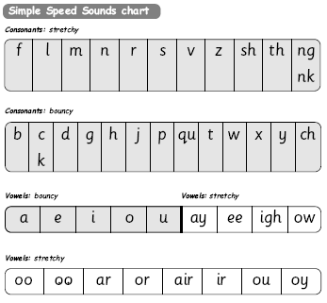
Teaching Phonics – Part 1: Speedy Sounds
Special friends... 2 letters that make 1 sound.
We teach Speedy Sounds at the beginning of every session, every day. We may introduce a new sound or review the sounds previously taught. We learn the sound and the rhyme for each phoneme.

Slide 11
Part 2: Word Time: Blending & Segmenting - ‘Fred Frog’
Word Time -We apply our knowledge of the sounds and practise blending (reading) and segmenting (spelling) using Fred Frog. Our aim is to be fast and confident!
Fred Talk – Fred the frog can say the sound in words but he cannot say the whole word so children help him e.g. c-a-t ‘cat’
Fred in your Head – Once children can sound out a word, we teach them to blend in their heads.
Fred Fingers – The children count the number of sounds in a word on their fingers. Some of our children find this very tricky!

Slide 12
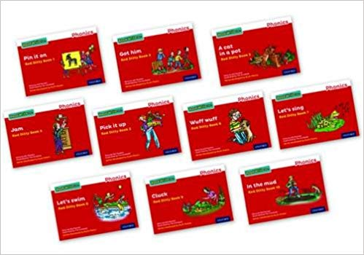
Part 3: Shared Reading
After children have learnt enough sounds AND they can oral BLEND confidently and quickly they will begin to read books from the RWI scheme:
*Sound Blending books
*'Ditty' books
*RWI Colour Banded books
The children will work with a partner when reading. They will read the same book several times during the week and then answer set questions to develop comprehension skills.

Slide 13
Green Words & Red Words
When we read RWI books the children will see:
*Green Words - These are decodable. The children can sound them out to read the words.
(Once they have learnt to blend)
*Red Words – They can be very tricky! They are common words which can be difficult to blend or have an uncommon spelling e.g. ‘said’.

Slide 14
Home Reading Material
*All pupils will receive a ‘Book for Enjoyment’ | This book is matched to your child’s reading age (not reading ability) so they will need support to read this text. | Your child will choose their own ‘Enjoyment Book’. They will change their book weekly.
Step 1: Learning single letter sounds and developing oral blending skills. | Please practise the sounds on your child’s Sound Mat regularly. Practise Fred Talk too. | We will assess your child regularly. We will send videos on Tapestry to support your child’s learning.
Step 2: Learning to read simple written words. | Your child will receive a Blending Book (a small, purple, rectangular book with one word to a page). | Your child will read Blending books in their Phonics lesson. We will send home a new Blending Book each week.
Step 3: Reading simple captions. | Your child will receive a Ditty Sheet. This is a photocopied sheet, not a book. | Your child will read a Ditty sheet in their Phonics lesson. We will send home a new Ditty each week.
Step 4: Developing pace and fluency. | Your child will receive a RWI Book. The colour banding will be matched to their reading ability (post-assessment). | Your child will read a RWI book in their Phonics lesson. We will send home a new book each week.

Slide 15
Home Reading Material cont.
*Reading Record – Parents will receive a Reading Log with their child’s reading book. Our whole school reading policy requests that you read with your child four times a week (or more). This does not mean your child needs to read their school book every time. It may include their ‘Reading for Enjoyment’ text, a library book, a magazine or comic or a bed time story you share with your child.

Slide 16
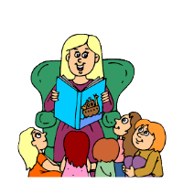
Daily Story Time
*We read stories every day!
*PLEASE continue to read to your child too!
*It’s good practise to read the same stories over and over again. Children thrive on repetition!

Slide 17
On Track…
*If your child is finding it difficult to stay ‘on track’, they will receive Tutoring in school. This intervention is part of the RWI scheme and is designed to support your child to ‘keep up’.
*Practise, practise, practise! There is no magic key when learning to read. Your child needs to practise the sounds they are finding challenging, frequently. Your child will receive QR codes; scan the QR code to find a RWI clip to support your child’s learning.

Slide 18
At Home
*Our aim is to encourage confidence and a love of reading!
*Reading needs to be a quiet time with very little distraction.
*Some children will be more interested than others.
*Your child is working very hard and having lots of fun at school. They may not want to read when they get home; let them listen to you read instead.
*Could we kindly ask that you do not put water bottles in book bags. We need to take good care of all our books.

Slide 19



Writing in FS2 -
Talk for Writing, Handwriting &
Writing Words and Sentences

Slide 20

‘Talk for Writing’ Journey (Communication & Language)
*We teach writing genres through ‘Talk For Writing’.
*We will use 6 fiction texts to support your child’s writing journey.
*We will also use non-fiction texts and poetry.
*Each writing journey lasts approximately 3 weeks.

Slide 21
Writing Toolkit
In FS2, we use a simple ‘toolkit’ to learn writing techniques:
Characterisation
Setting
Openings & Endings
Description

Slide 22
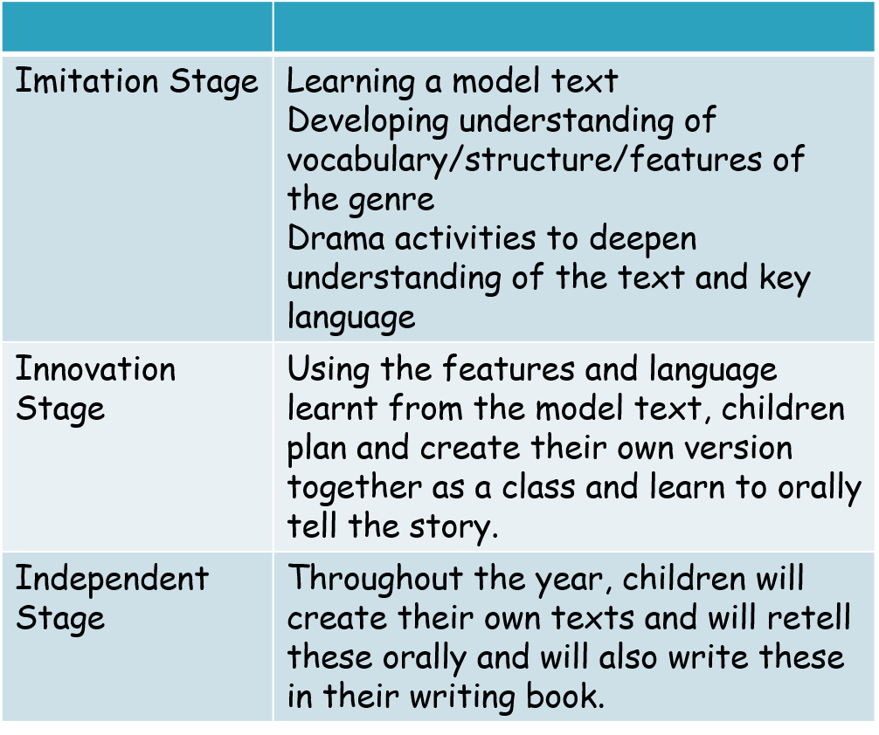
FS2 - Writing Stages

Slide 23
FS2 - Writing Stages
*Imitation Stage –
Hook – Children are hooked into their new writing journey with an activity e.g. text ‘Whatever Next’ – launch a rocket outside!
Children will learn to orally tell a story or non-fiction text, using a story map and actions.
We learn the texts in many different ways:
Interviewing a character (Hot Seating), Retell using different voices, Act out different parts of the story (Charades), Copy miming different parts of the story (Mirroring), Create own Story Maps (S Plans).

Slide 24
FS2 - Writing Stages
*Innovation Stage –
We edit our Story Map as a class to make a new version of the story. The children make simple changes e.g. changing the main character, the setting, the ending etc, by adding post-it notes to our Story Map.
*Independent Stage –
Children now retell their own version of the text, in Talk for Writing sessions and Continuous Provision.
This is where the children can take real pride in their work throughout their journey, as they show they have made progress in their story telling/imagination skills.

Slide 25
FS2 – Talk for Writing
*Teacher to ‘talk’ the text first – Story Brief
*Together, write a Story Map – key language and images.
*’Read’ the Story Map, using actions.
*Children to internalise the text – During Continuous Provision, children are encourage to retell the story, using mark making, ‘S plans’ with images and words and role play.

Slide 26
Writing – Physical Development
Writing starts with the whole body!
Before children can control a pencil, they need to develop strength and control throughout their body.
The shoulders help provide stability.
The elbows help control arm movements.
The wrists help guide movements and change direction.
The hands and fingers develop the control needed for smaller marks and letter shapes.
Think of it as a journey: Big movements first, then smaller, more controlled movements.

Slide 27
Writing – Gross & Fine Motor Control
The 3 pivots of writing - The pivot is the joint or area around which a movement is controlled.
1. Shoulder - big movements
Helps children move their whole arm and build shoulder stability.
Try: painting on an easel, drawing huge circles in the air or making road maps on large paper.
2. Elbow - controlled movements
Helps children move the forearm to make lines and shapes with more control.
Try: drawing long roads, making zigzags or tracing large shapes.
3. Wrist - smaller, precise movements
Helps guide the hand and supports more controlled drawing and early letter formation.
Try: drawing small circles, making patterns or using chalk and short crayons.

Slide 28
Writing - Crossing the Middle Line
What does it mean?
Crossing the midline means reaching across the imaginary line down the middle of our body - for example, using the right hand to reach towards the left side.
Why does it matter for writing?
Encourages children to reach across the page smoothly.
Supports coordination between both sides of the body.
Helps children develop comfortable, continuous movements when drawing and writing.
Can support the development of a preferred writing hand.
Try these activities:
Draw a big sideways figure of eight.
Make rainbow arcs from one side of the paper to the other.
Stick targets on both sides and ask children to reach across their body to touch them.
Draw roads across a large sheet of paper without swapping hands unnecessarily.
Tip: Encourage children to use their preferred hand naturally. Avoid forcing a child to cross the midline or changing hands for them.

Slide 29
Writing Progression in FS2
Your child’s writing will progress in the following stages:
*Mark making – scribbling, circles, lines
*Recognisable letters (usually from their name).
*Simple words
*Captions
*Simple sentences

Slide 30
Support your Child’s Writing
*What does your child want to write? e.g. I sing in my bed.
*’I’ and ‘my’ are red words. We cannot sound out these words so give your child the correct spelling.
*Use Fred Fingers for all decodable words. Say the word ‘sing’. Stress the word, pinching 3 fingers e.g. s-i-ng. Can your child hear the sounds? Do they know what the sound looks like? Use the letter rhymes to write the sounds.
*Longer words: your child can only write the sounds they can hear. They will leave out some sounds in words (spell incorrectly). At this early writing stage, we are teaching the children to segment. Spelling correctly will develop as they progress through the RWI scheme, once they have learnt all the sounds.

Slide 31
Support your child’s writing
*Pencil Grip:
-Place the pencil point towards the child’s chest/tummy.
-Use ‘Pinchy Parrot’ fingers (thumb and index finger) to pick up the pencil (approximately 1 cm away from the point for right hand and 2/3cm for left hand).
-Put the pencil ‘to bed’. (Rest the pencil on the pad between the thumb and finger.)
-The end of the pencil should point towards the child’s shoulder.
*We start by using plain paper (including large sheets for big mark making) and then encourage the use of lined paper (solid lines and dashes) so your child can clearly see tall and long letters.
* Avoid tracing, dotted letters or correcting every spelling, as children need opportunities to explore, experiment and develop their own independent writing skills.

Slide 32
Activities to Try at Home-
Big movements
Draw with chalk outside, paint on large paper, make shapes in the air or move like a giant drawing a rainbow.
Hand strength
Squash playdough, roll little balls, squeeze sponges during water play or use child-safe tongs to move objects.
Early writing
Use chunky crayons, draw lines and circles, make pretend shopping lists or write cards together.
Crossing the midline
Place stickers on both sides of a large piece of paper and encourage your child to reach across to decorate it.

Slide 33
Parents as Partners in FS2
Children learn best when school and home work together. Small, everyday routines make a big difference!
We know every child develops at their own pace, but there are some really important skills we can work on together.
We want the children to become independent, confident and ready to learn.

Slide 34
Supporting your Child at Home
Personal, Social & Emotional Development:
Encourage kindness, sharing, turn-taking, kind hands and talking about feelings. Encourage your child to try again when something is difficult.
Independence:
Practise dressing, putting on coats, shoes and fastenings, using cutlery at mealtimes, independent toileting and handwashing.

Slide 35
Building Independence
Please encourage your child to have a go at:
Putting on their coat and shoes.
Managing their own belongings and book bag.
Using the toilet and washing their hands.
Tidying away toys and following simple instructions.
Trying tasks before asking an adult to do them.

Slide 36
Basic Everyday Skills
Share a book or story every day.
Enjoy rhymes and songs.
Practise recognising their name.
Count everyday objects together - toys, stairs and snacks.
Practise recognising numbers through play - spot numbers, compare amounts and talk about shapes and patterns.
Practise recognising sounds and letters through play.
Celebrate effort, resilience and having a go!

Slide 37
Finally…
Please encourage them to have a go. We are not expecting perfection - we are looking for practice, progress and a willingness to try
Please practise these skills regularly. Allow extra time for your child to try, make mistakes and learn.
These skills are interconnected: a child who can communicate their needs, manage their belongings and persevere with a task is better equipped to access the whole FS2 curriculum.
We are asking parents to work in partnership with school, not to become teachers at home.

Slide 38
Thank you!!
Any questions?

